Slide 1
Chapter Four
Current and Resistance

Slide 2
In the First Semester we were talking about the physics of
stationary charges ‘Static Charges’, which is know as
‘Electrostatic’.
In the Second Semester we will talk about the physics of
the motion charge ‘Moving Charges’, which is known as
‘Electric Current’

Slide 3

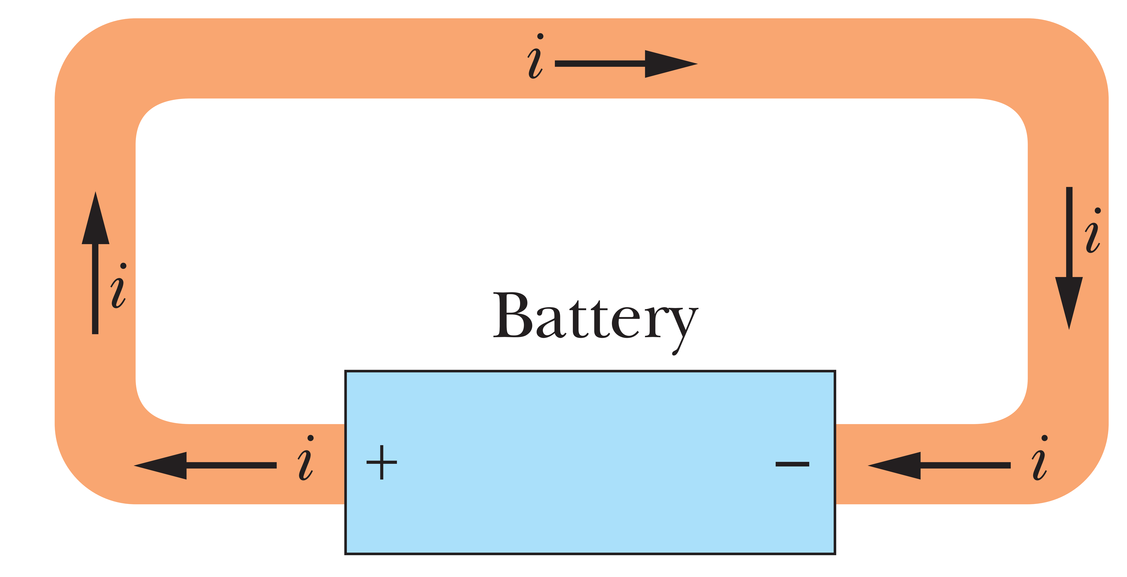
4-1 Electric Current
Although an electric current is a stream of moving charges, not all moving charges constitute an electric current.
A loop of copper in electrostatic equilibrium. The entire loop is at a single potential, and the electric field is zero at all points inside the copper.
Adding a battery imposes an electric potential difference between the ends of the loop.
Electric fields act inside the material making up the loop, exerting forces on the conduction electrons, causing them to move and thus establishing a current.
There is no net transport of charge and thus no current through the wire.
Notes:
The free electrons (conduction electrons) in an isolated length of copper wire are in random motion at speeds of the order of 106 m/s. If you pass a hypothetical plane through such a wire, conduction electrons pass through it in both directions at the rate of many billions per second—but there is no net transport of charge and thus no current through the wire.

Slide 4
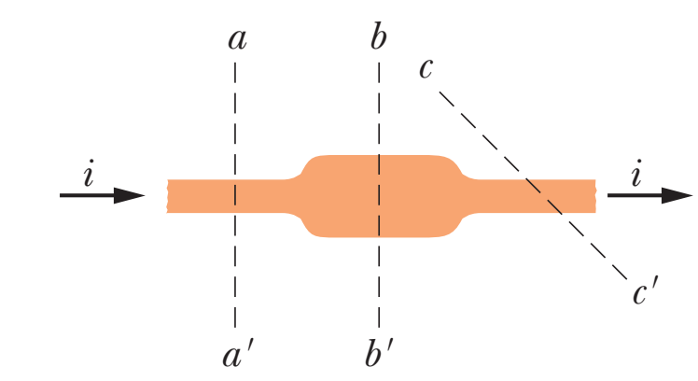
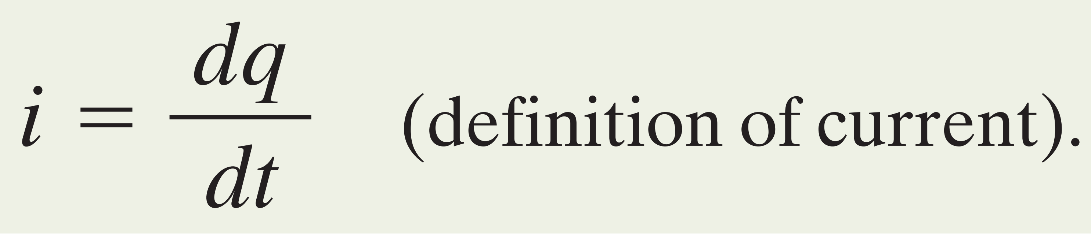
If charge $dq$ passes through a hypothetical plane (such as aa’) in time $dt$, then the current $i$ through that plane is defined as
Current is scalar not vector
not ‘1 Amp North’ just ‘1 Amp’

Slide 5
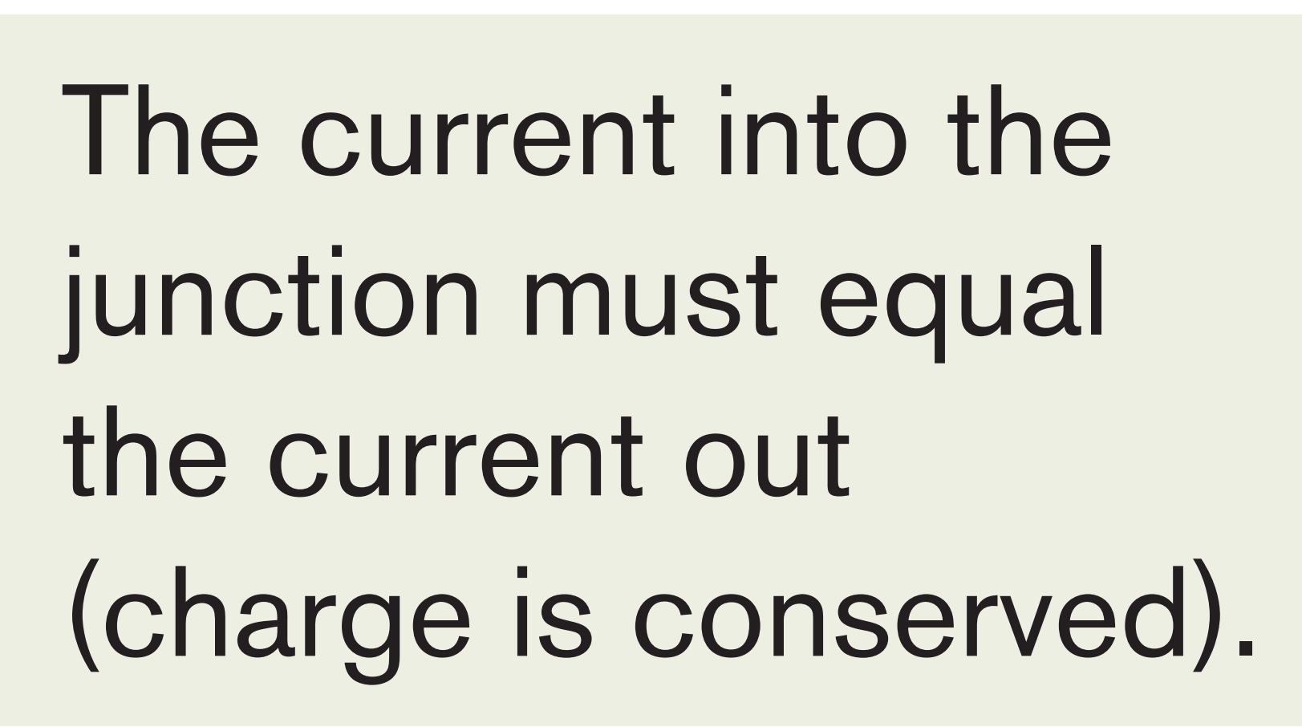

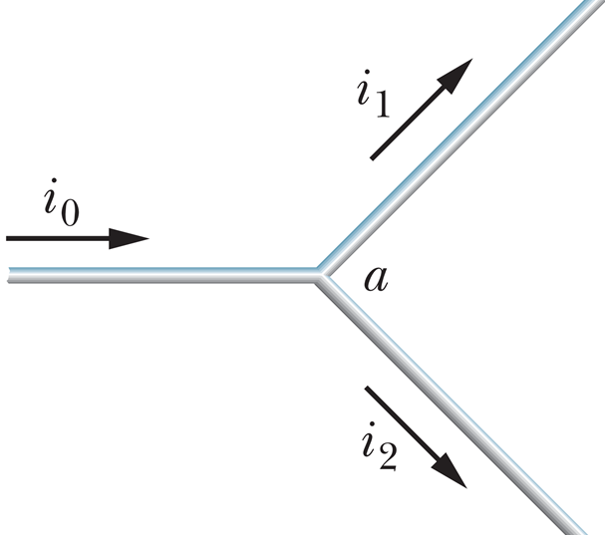
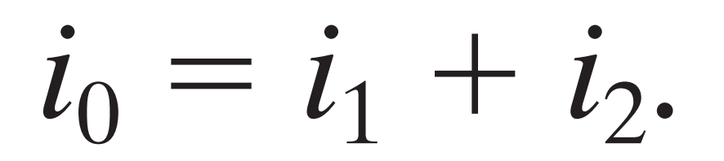
For historical reasons, we use the following convention:
A current arrow is drawn in the direction in which positive charge carriers would move, even if the actual charge carriers are negative and move in the opposite direction.

Slide 6
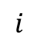
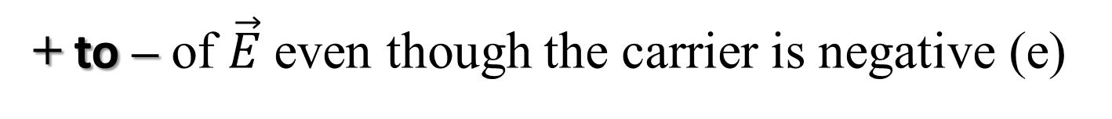
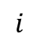

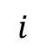
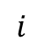
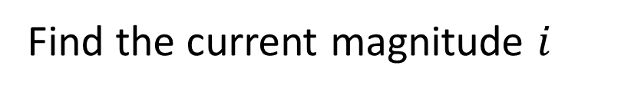
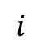
The direction of Electric Field vector $\vec{E}$ from
+ to -
The current direction from
+ to – of $\vec{E}$ even though the carrier is negative (e)
Find the current magnitude $i$
2A
2A
2A
$$i$$
2A
2A
$$i$$
6A
6A
6A
$$i$$
$$i$$
$$i$$

Slide 7
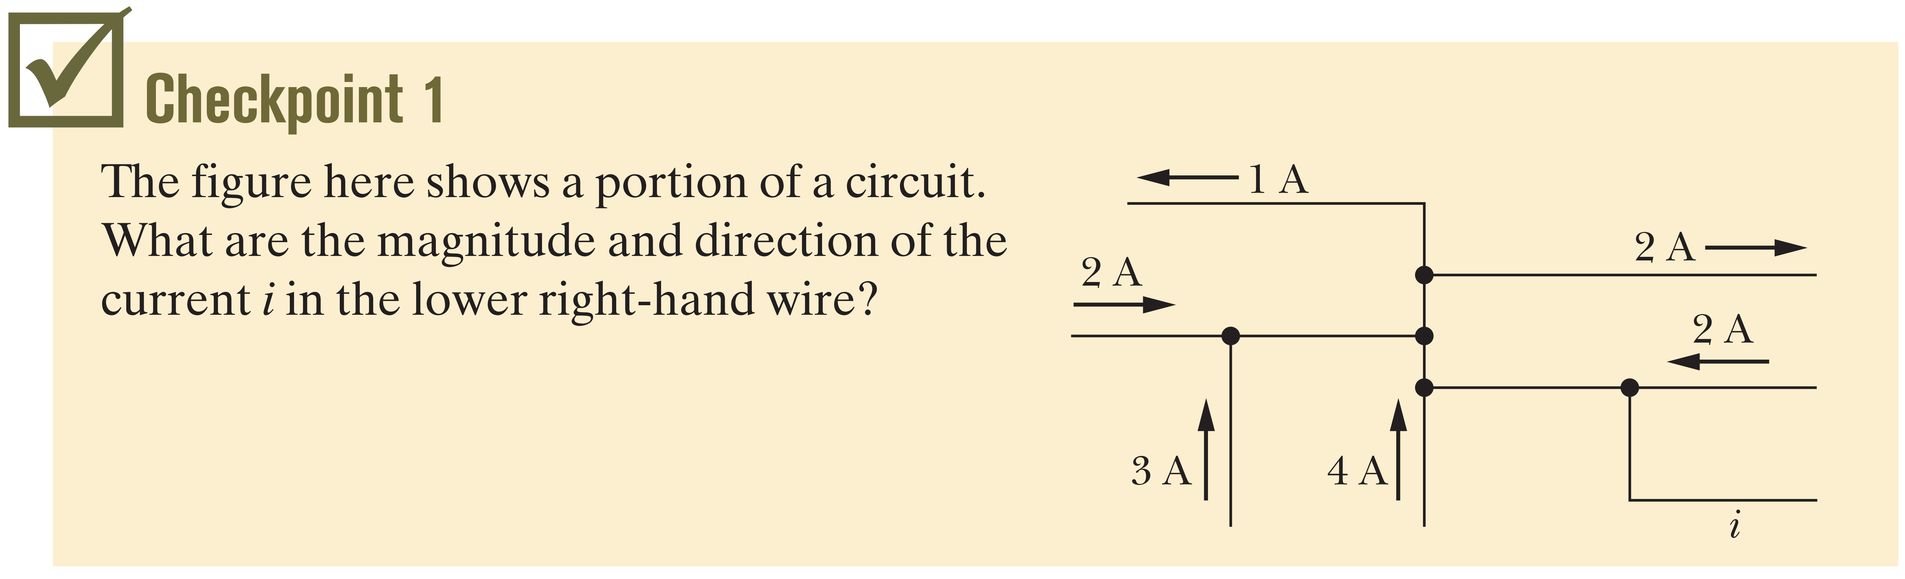
5A
3A
2A
6A
8A

Slide 8
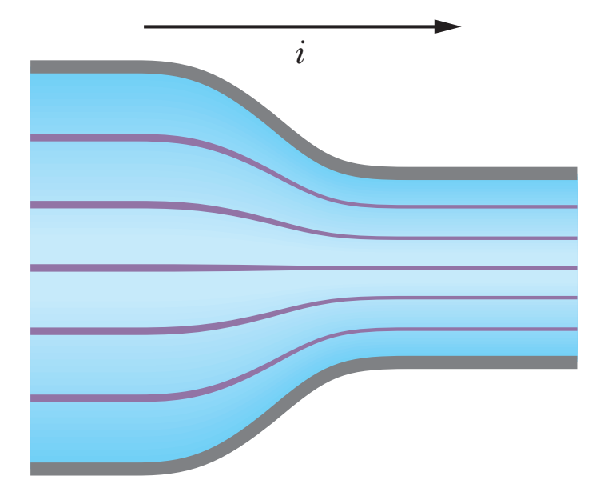
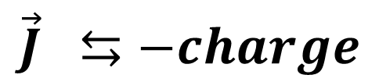
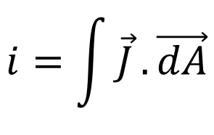
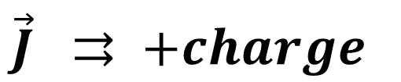
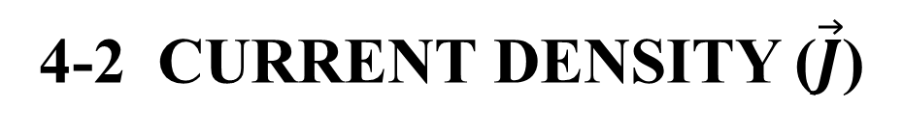
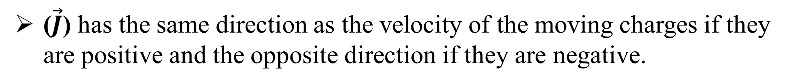
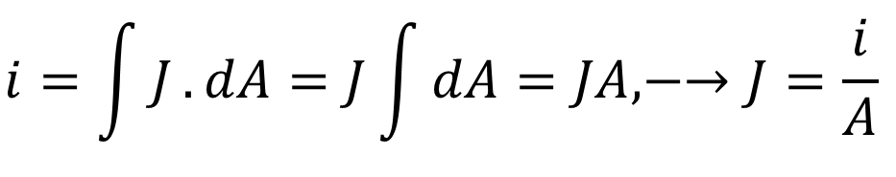
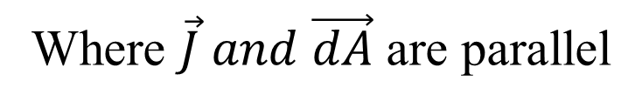
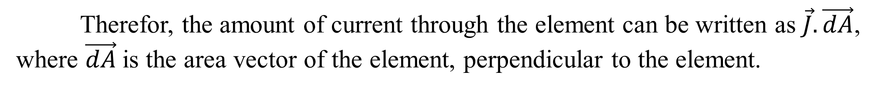
4-2 CURRENT DENSITY ($\vec{J}$)
To study the flow of the charges through cross section of conductor at the particular
point.
Therefor, the amount of current through the element can be written as $\vec{J}.\vec{dA}$, where $\vec{dA}$is the area vector of the element, perpendicular to the element.
$$i=\int{\vec{J}}.\vec{dA}$$
Where $\vec{J} and \vec{dA}$ are parallel
$$i=\int{J}.dA=J\int{dA}=JA,−→J=\frac{i}{A}$$
The magnitude J is equal to the current per unit area through that element.
($\vec{J}$) has the same direction as the velocity of the moving charges if they are positive and the opposite direction if they are negative.
$\vec{J} ⇉ +charge$
$$\vec{J} ⇆−charge$$

Slide 9
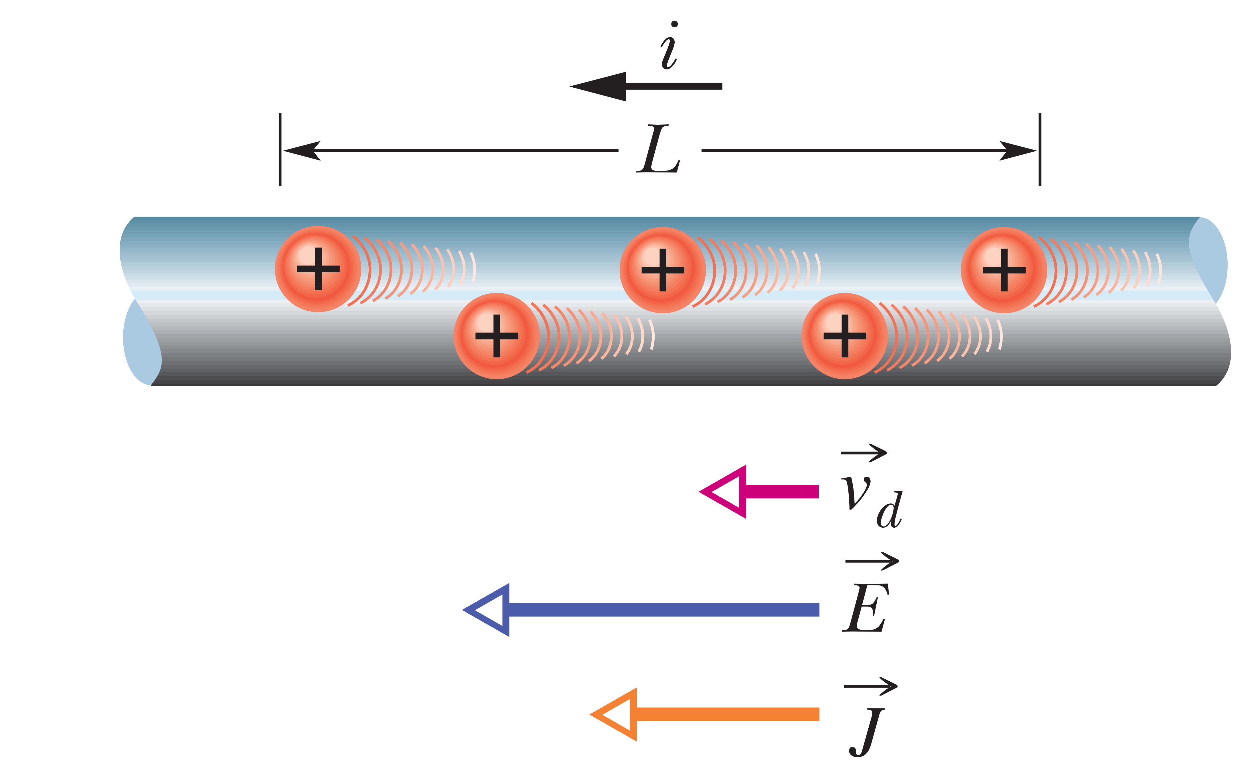
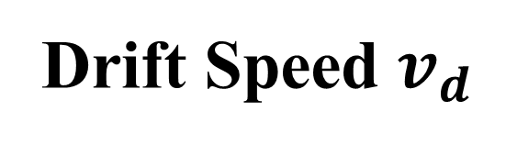
Drift Speed $v_{d}$
When the conductor does not have bias (no applied electric field), the conduction electrons move randomly, with no net motion in any direction.
+
+
+
+
+
+
+
Current is said to be due to positive charges
that are propelled by the electric field.

Slide 10
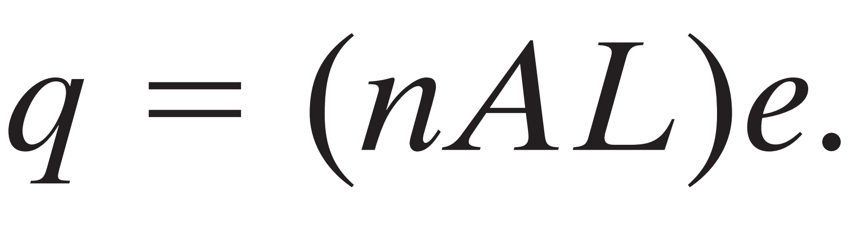
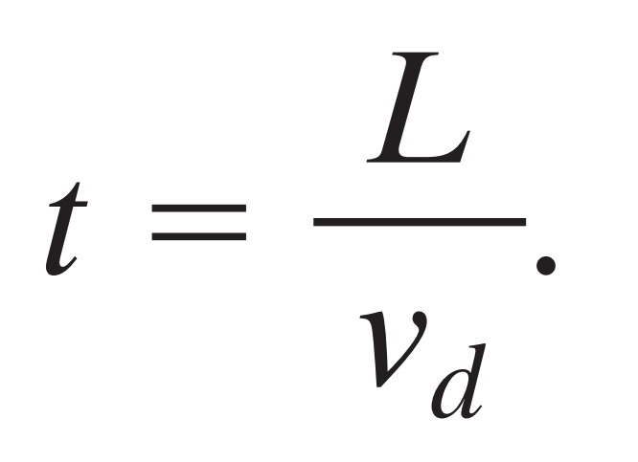
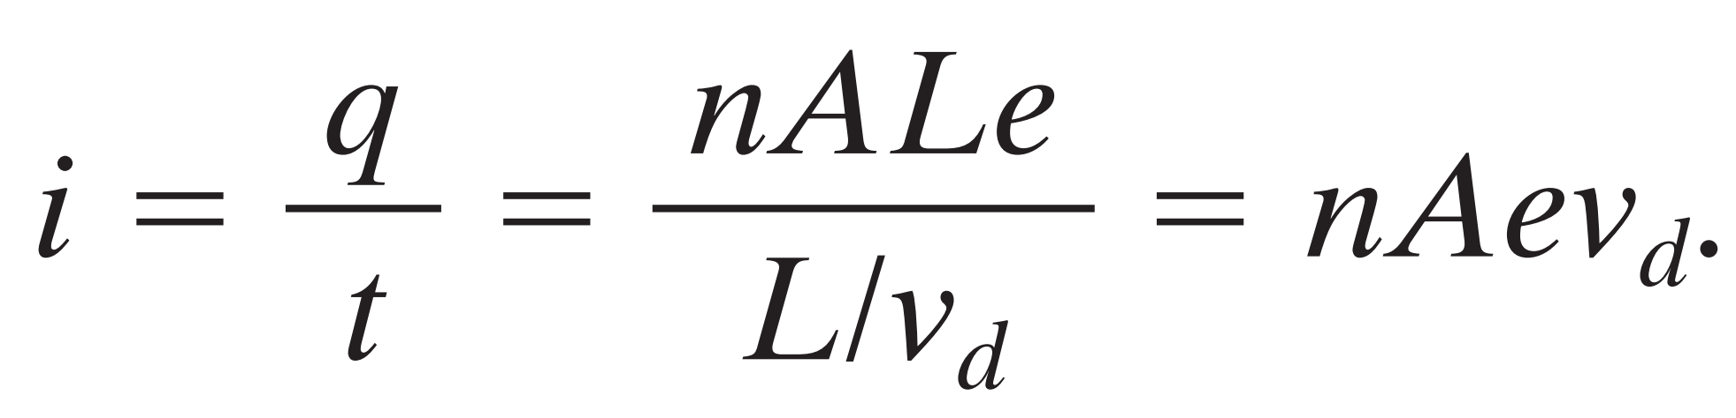
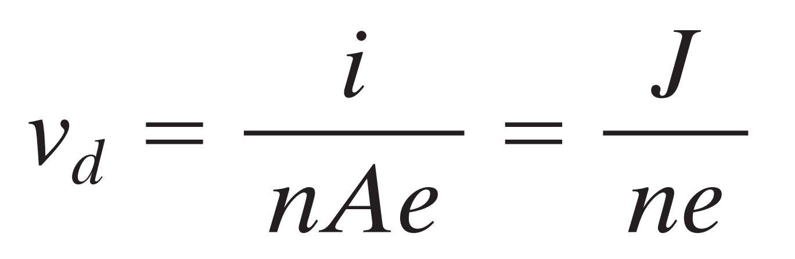
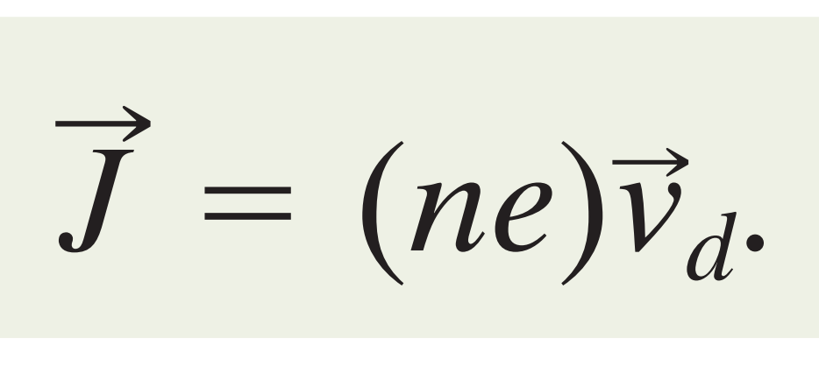
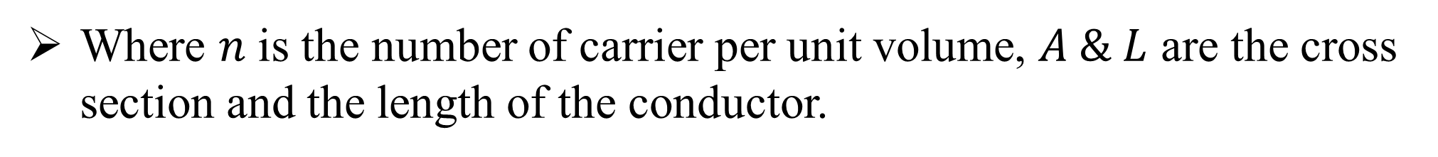
The number of charge carriers
Where $n$ is the number of carrier per unit volume, $A \& L$ are the cross section and the length of the conductor.
Total charge moves through any cross section of the wire in the time interval
The current$i$is the time rate of transfer of charge across a cross section

Slide 11
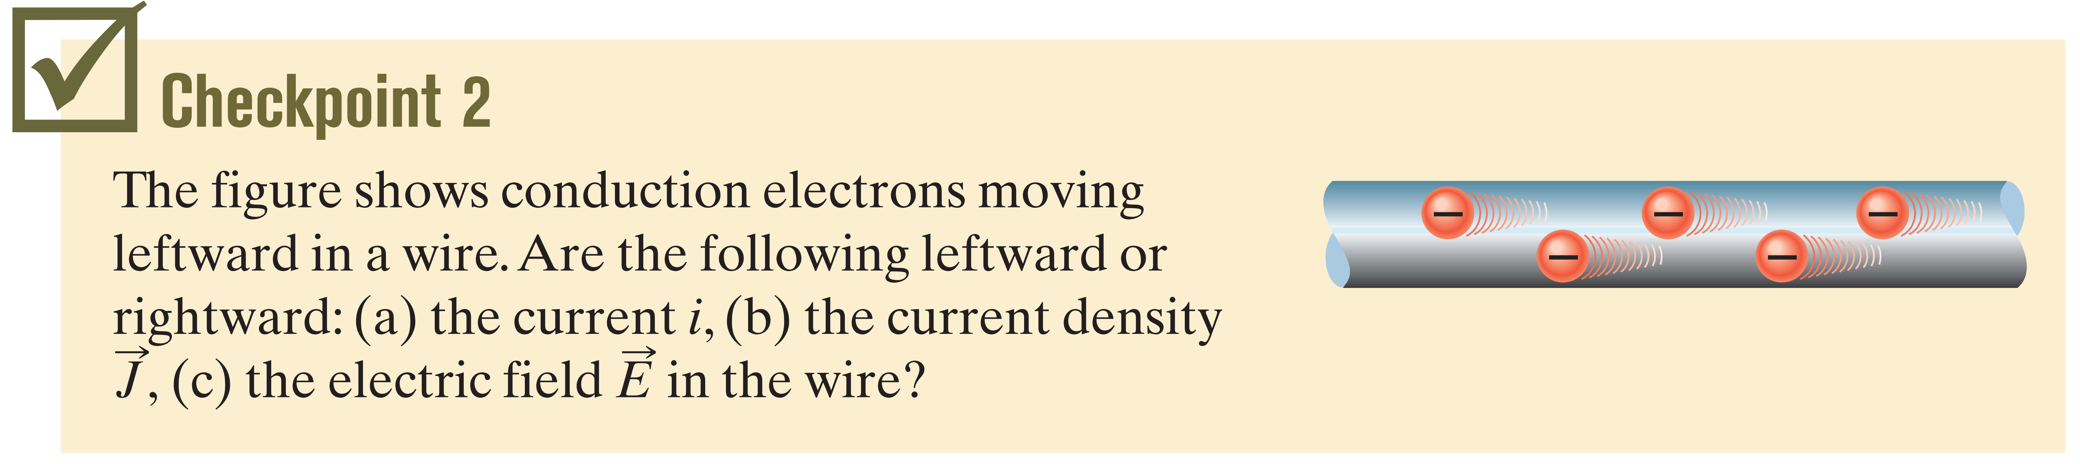
(a)-(c) rightward

Slide 12
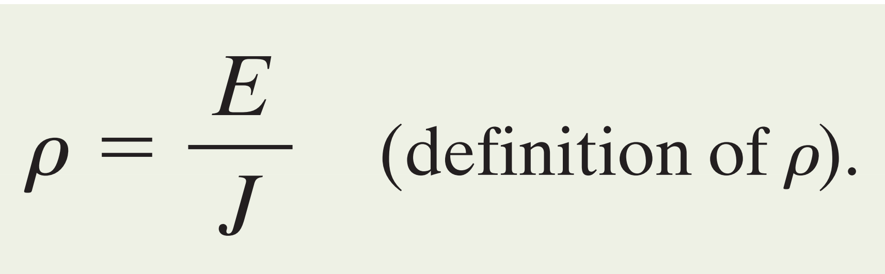
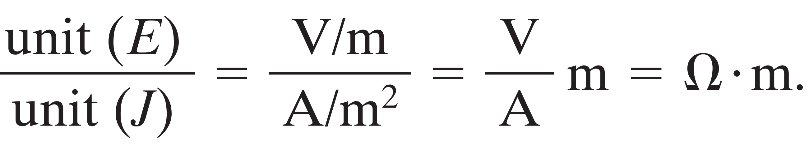
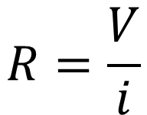
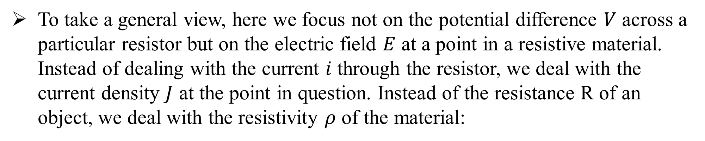
4-3 RESISTANCE AND RESISTIVITY
The resistance ($R$) is determined between two points of a conductor by applying potential
difference $V$ between two those points and measuring the current $i$ that result.
$$R=\frac{V}{i}$$
To take a general view, here we focus not on the potential difference $V$ across a particular resistor but on the electric field $E$ at a point in a resistive material. Instead of dealing with the current $i$ through the resistor, we deal with the current density $J$ at the point in question. Instead of the resistance R of an object, we deal with the resistivity $ρ$ of the material:

Slide 13
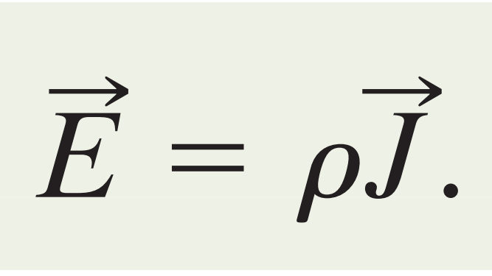
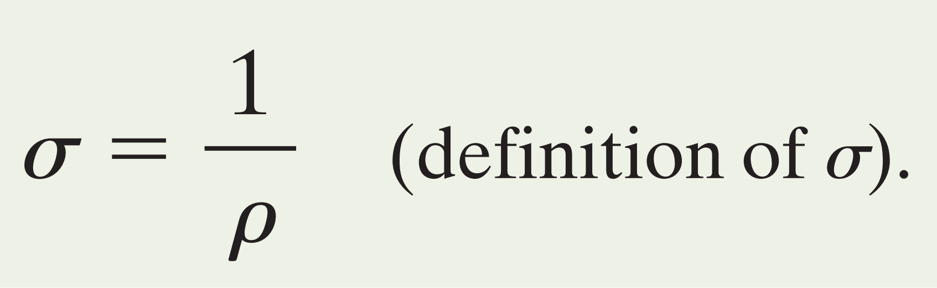
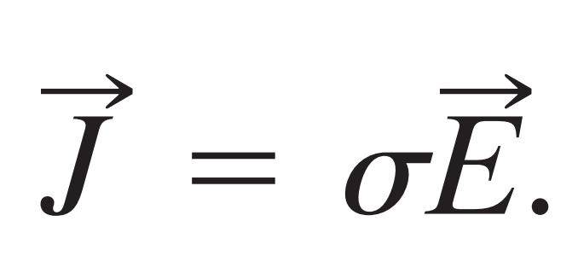
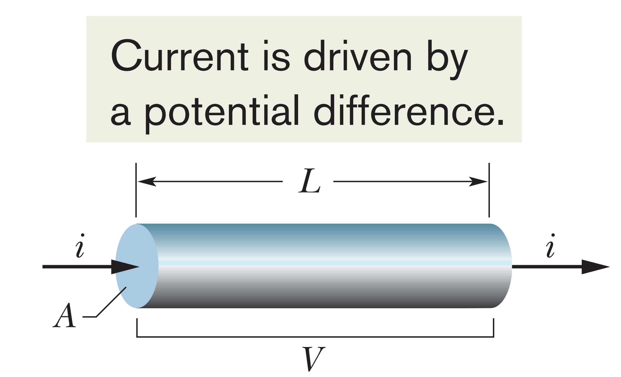
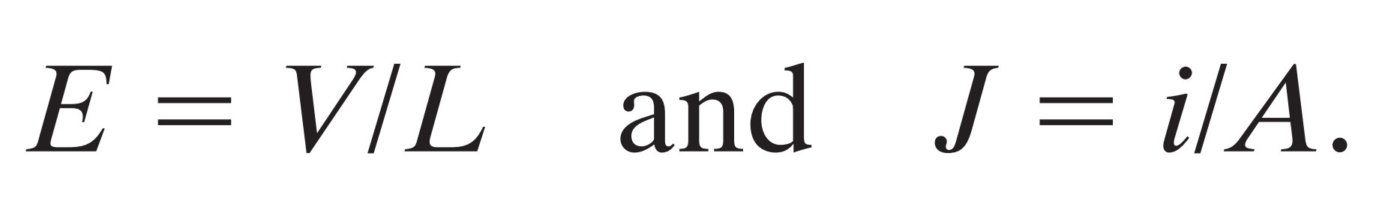
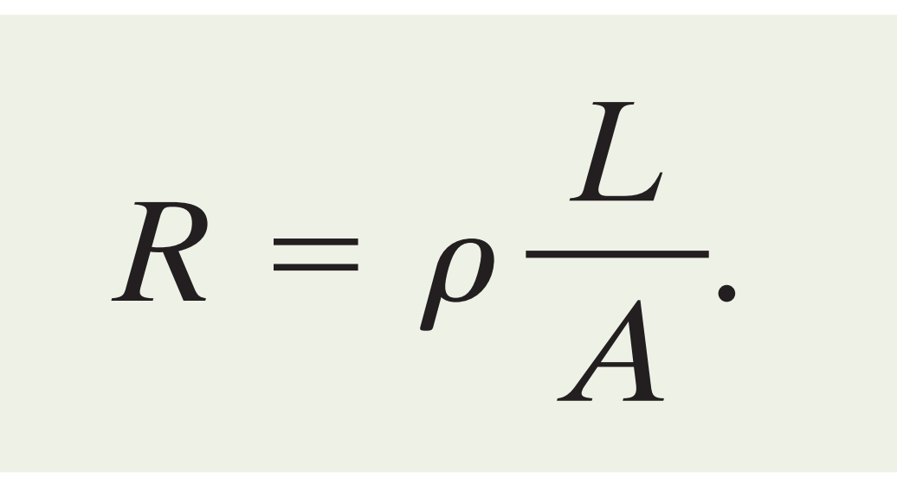
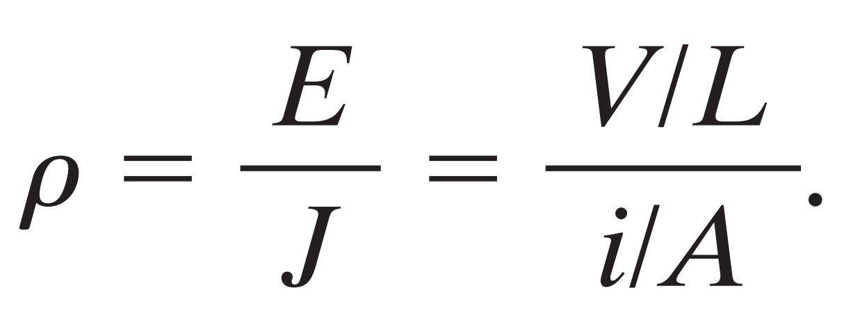
In vector form as
Conductivity

Slide 14
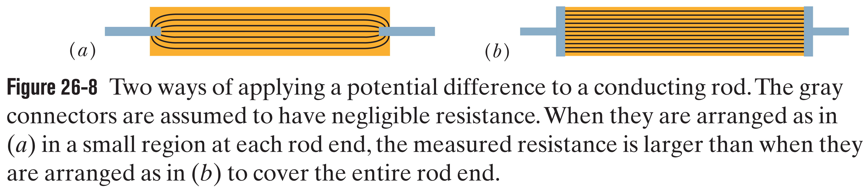
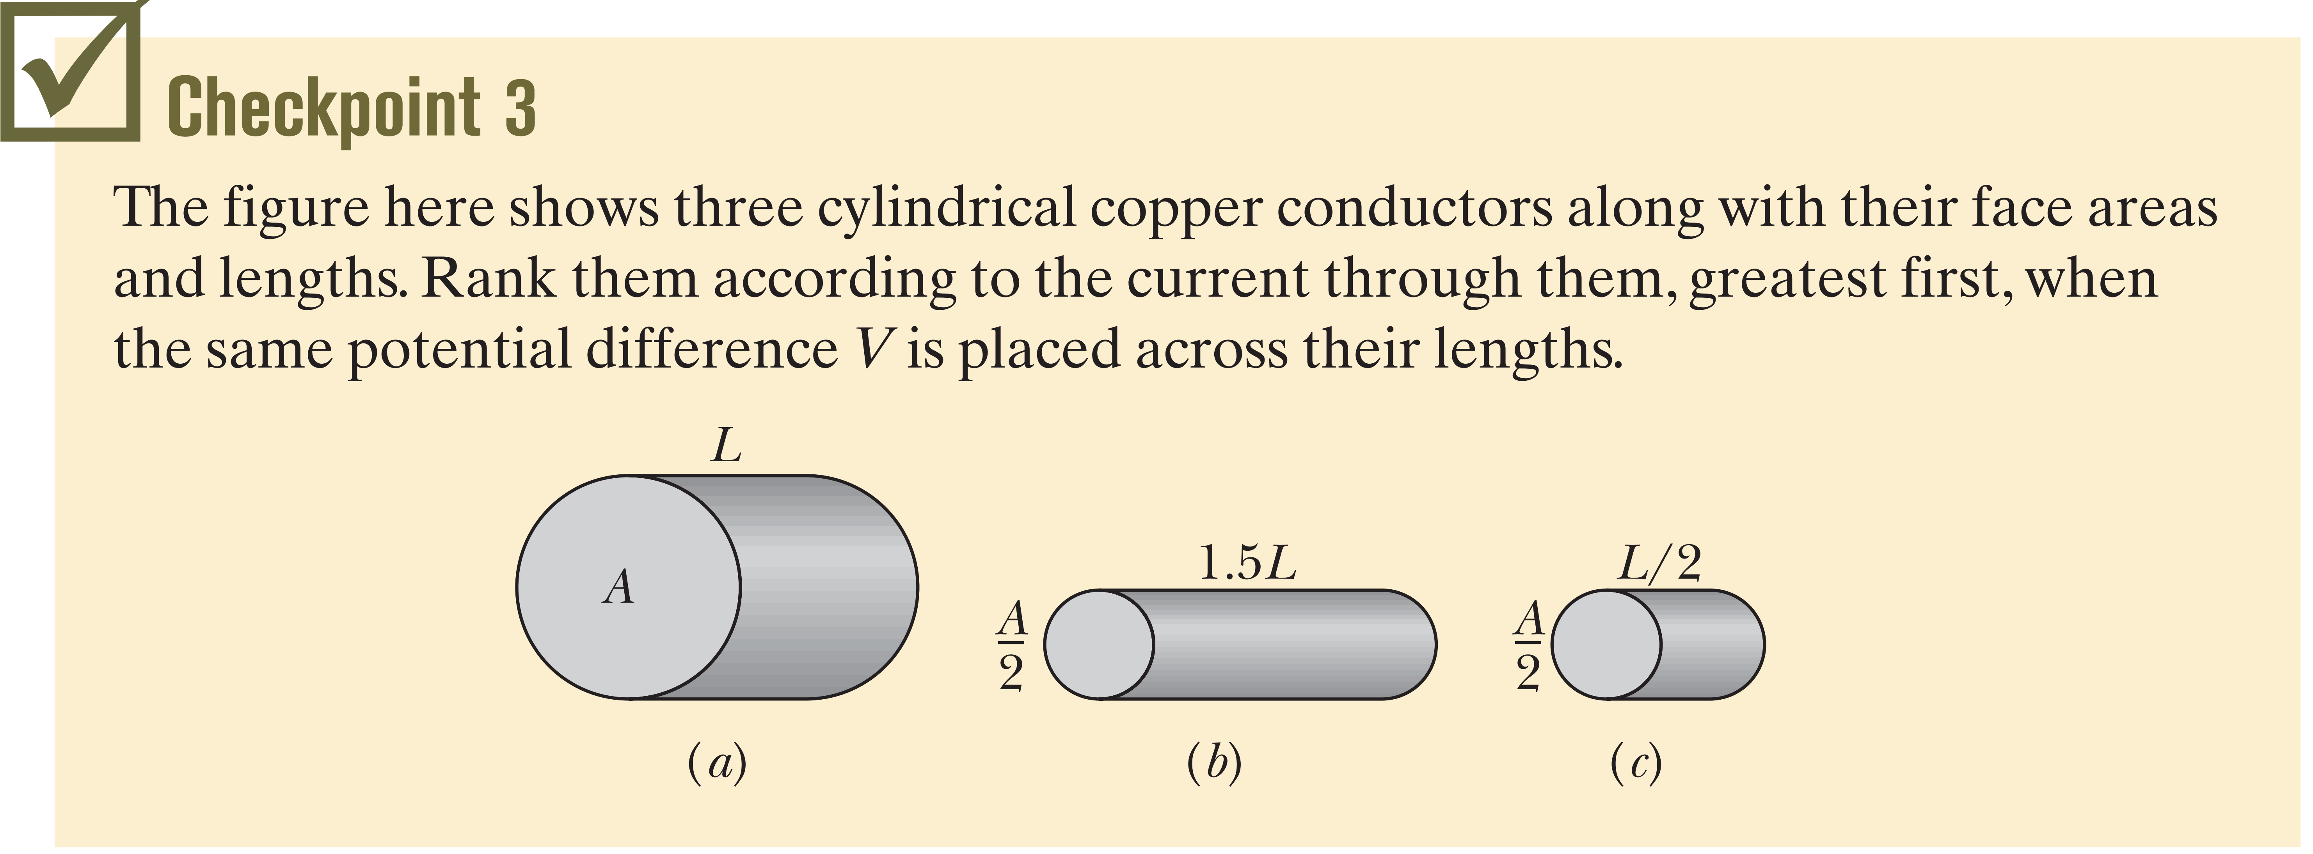
a and c tie, then b

Slide 15
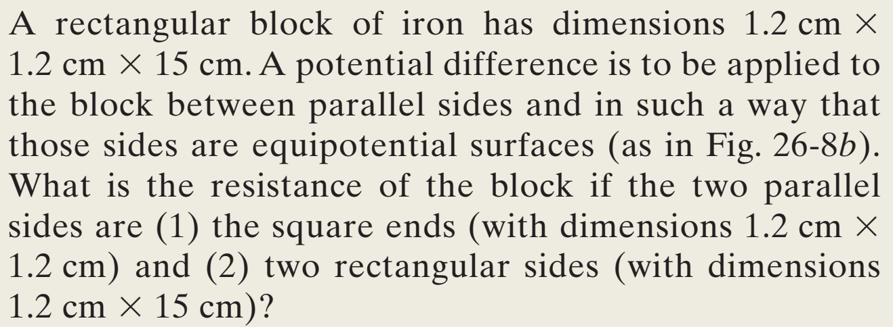
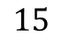
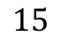
Sample Problem 26.04
1.2
1.2
1.2
1.2
$$15$$
$$15$$

Slide 16
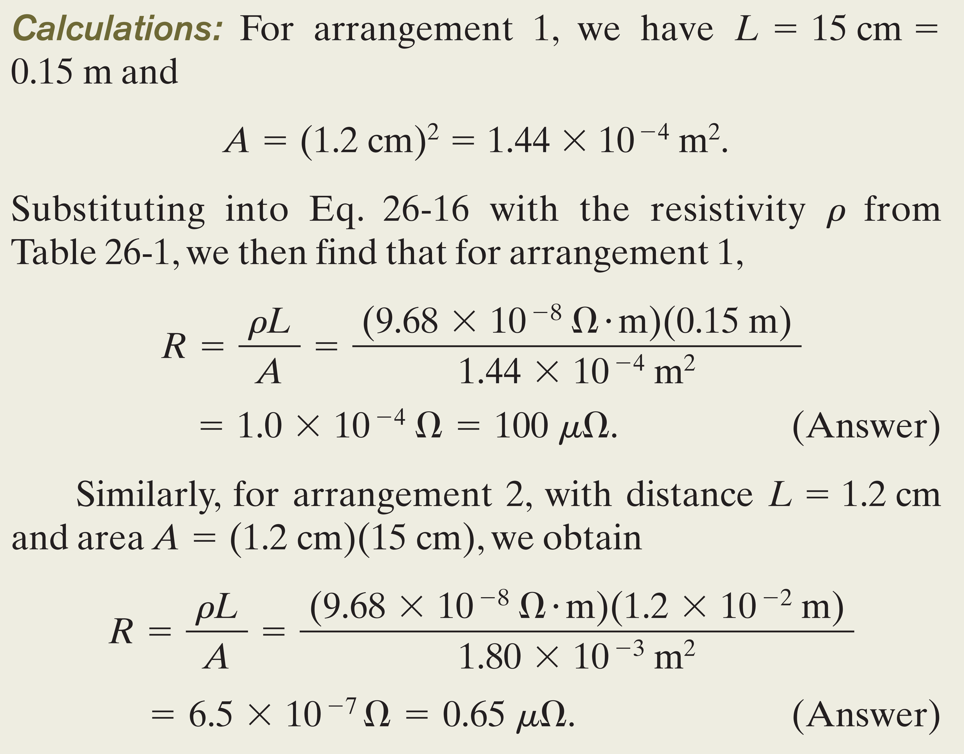
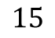

1.2
1.2
$$15$$
1.2
1.2
$$15$$

Slide 17



4-4 OHM’S LAW $R=\frac{V}{i}$
Linear
If the $i$ versus $V$ is straight line, means the Resistance ($R$) is independent of the magnitude and polarity (direction) of applied potential difference ($V$).
The linearity between $i$ and $V$ indicate that the device has Ohmic Contact.

Slide 18

Nonlinear
Current can exist in this device only when the polarity of V is positive, and the applied potential difference is more than about 1.5 V.
We distinguish between the two types of device by saying that one obeys Ohm’s law, and the other does not.

Slide 19




Slide 20



A Microscopic View of Ohm’s Law
To find out why particular materials obey Ohm’s law, we must look into the details of the conduction process at the atomic level.
When we apply an electric field to a metal sample, the electrons modify their random motions slightly and drift very slowly.
The drift speed in a typical metallic conductor is about ($5×{10}^{−7}\frac{m}{s}$), less than the effective speed ($1.6×{10}^{6}\frac{m}{s}$) by many orders of magnitude.
If an electron of mass m is placed in an electric field of magnitude $E$, the electron will experience an acceleration given by Newton’s second law:

Slide 21








At any instant, on average, the electrons will have drift speed
Where $τ$ the average time between collisions
We have
which we can write as
We have
The formula states that metals obey Ohm’s law.
$m, n, e$ are constants and $τ$ the average time (or mean free time) between collisions, is a constant, independent of the strength of the applied electric field. Thus, because the right side of Eq. is independent of the field magnitude, metals obey Ohm’s law.

Slide 22





Sample Problem 26.05
(a) What is the mean free time $τ$ between collisions for the conduction electrons in copper?
Numerator
Denominator
The number of conduction electrons per unit volume in copper is
$n=8.49 ×{10}^{28} m^{−3}$.

Slide 23


(b) The mean free path $λ$, assume effective speed $v_{eff}$ is $1.6×{10}^{6} m/s$.

Slide 24




4-5 POWER
The decrease in electric potential energy from a to b is accompanied by a transfer of energy to some other form.

Slide 25

(a) and (b) tie, then (d), then (c)

Slide 26





Sample Problem 26.06
1-
2-

